Slide 1
Café Coffee Night
Marketing analysis Report to increase revenue

Slide 2
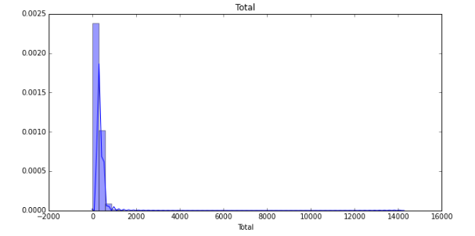
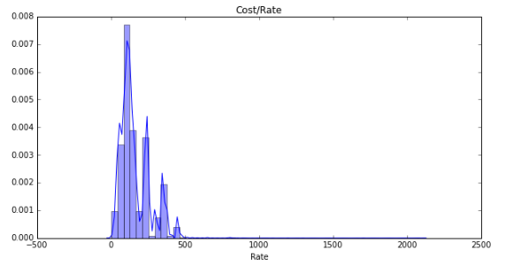
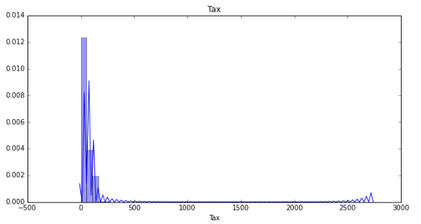
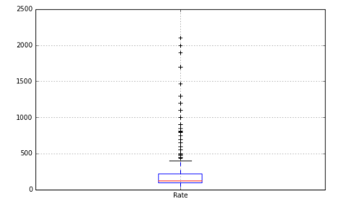
EDA
We can understand the distribution of Monitory values. The range here is very large i.e we have outliers. We can discard / re arrange the IQR range accordingly

Slide 3
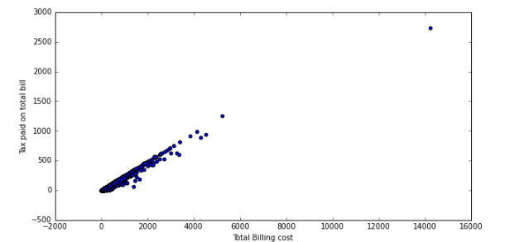
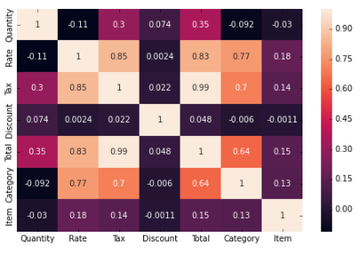
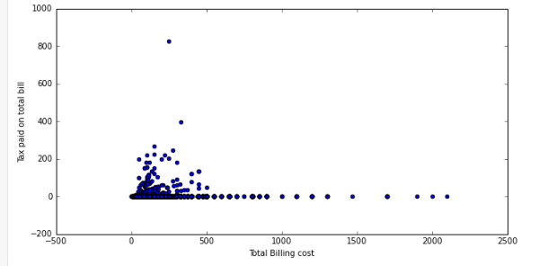
Correlations, Heat maps and Scatter plot
Discount feature has a high correlation with all the numerical features.
We can understand the negative correlation between increase in rate and sell in Qty.
Visualize outliers using scatter plot.

Slide 4

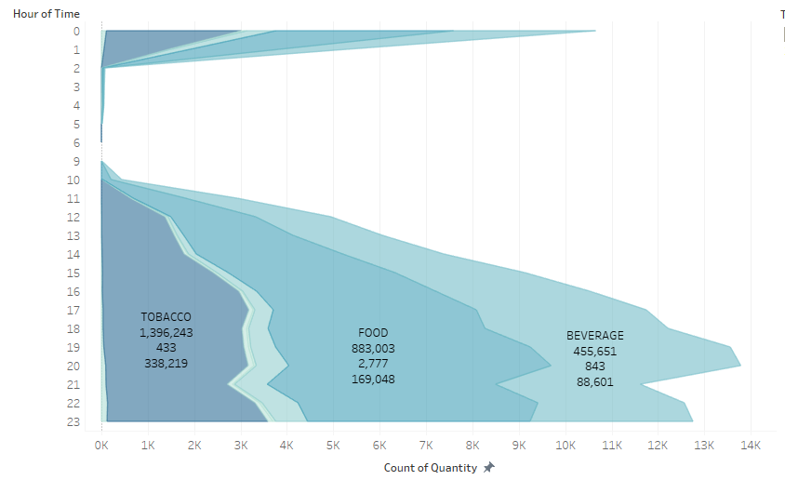
Hourly distribution of Sales
Hourly distribution of Sales
We can understand the max sales is at 20:00 and lowest in between 6:00 to 9:00
Tobacco being the most monitory category with highest Total and tax
Max discount is given for Foods since they are ordered the most.
We can notice a small drop in customers at 21:00 this might me due to the wrighting queue since the restaurant is fullat 20:00

Slide 5
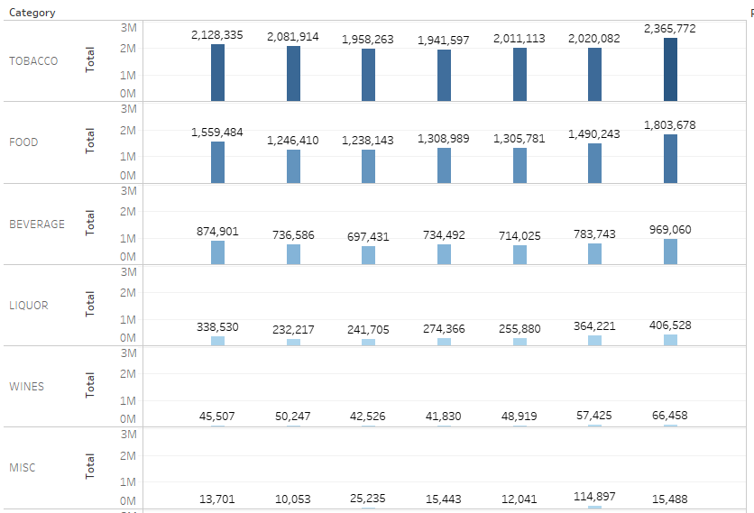
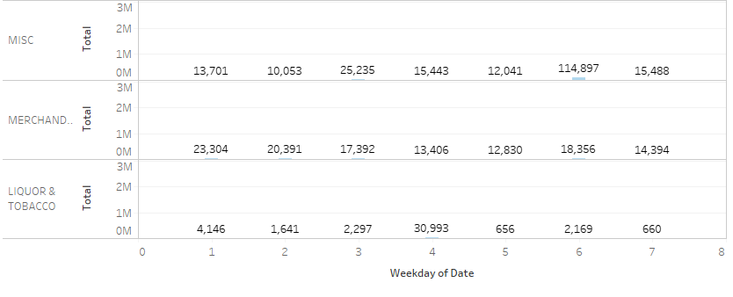

Sales of Category of Products -Weekly
Max sales of Tabacco, Food, Beverage, Liquor, Wines are on Week day 7 i.e Saturday
Max sale is of Micaceous (Party) on Week day 6 i.e Thursday
Max sale is of Merchandize on Week day 1 i.e Sunday
Max sale is of Liquor and Tobacco on Week day 4 i.e Wednesday

Slide 6
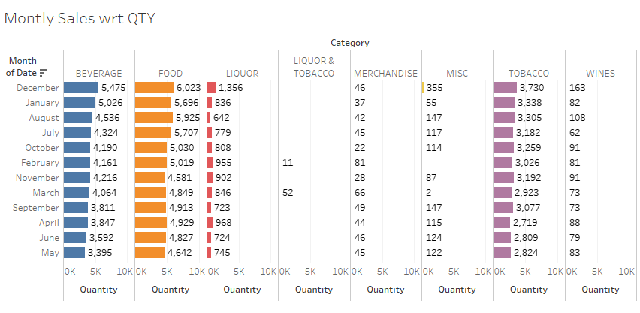
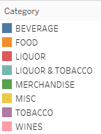
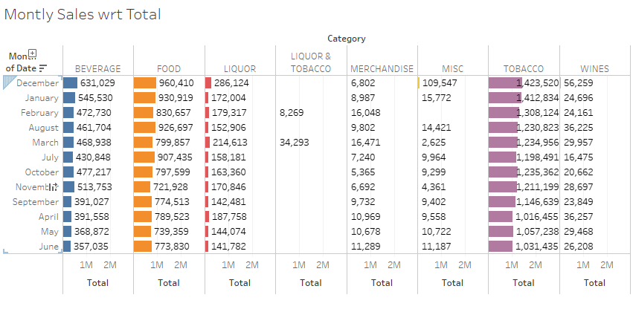
Monthly Product sales
December is the highest sales month w.r.t to Qty and Total.
While June being the lowest sale month

Slide 7
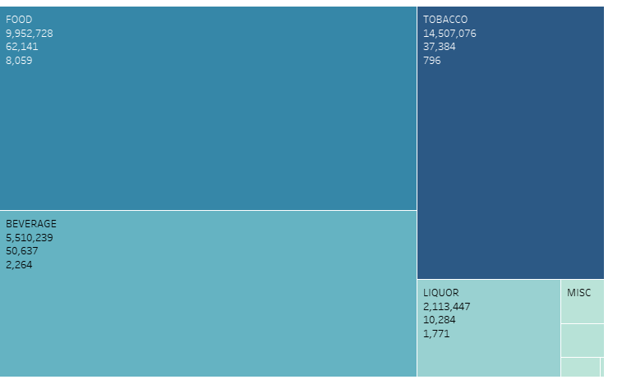
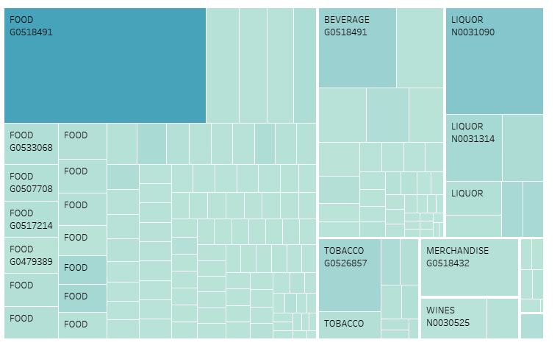
Product sold vs Quantity
Total
Qty
Discount
Merging the Billing together we get 69000 unique bills. With size as the discount, The max discount was given for 1818 for Food Category and max sales/ Total was 7067 for the same bill with food items of max 39 Qty served in a single order.
Product sold with highest bill cost was Tobacco but Product with max quantity was Food.
The max discount coupons were applied to Food because it had the max qty.
We can also infer that Most costly products of Liquor and tobacco are not customers favourite since it has the lowest sale and most costly and they can be discarded from the menu

Slide 8
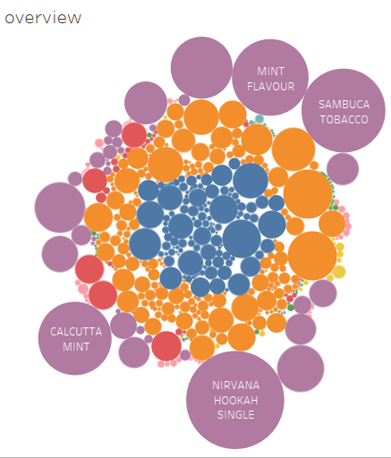
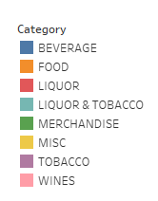
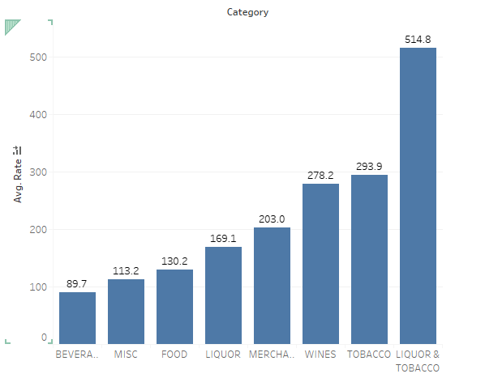
Café Coffee Night’s - Rates
Since Rates are high we can see the most costly items – Nirvana Hookah, Calcutta mint in Liquor & Tobacco Category

Slide 9

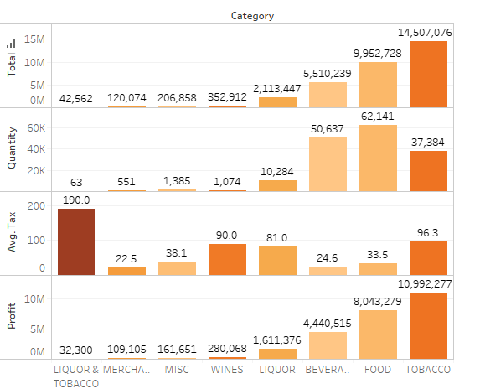
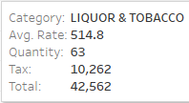
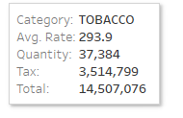
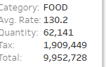
Product’s - Profit, Sales and Tax Analysis
The Liquor & tobacco are most costly with avg 514, Highly taxed and the Total and Qty both are less, the revenue is than 1%.
While the max Selling Product with respect to Qty is Food with average of 130 and with low Tax
Most Monitory product Tobacco has comparatively high rate of avg 240 and Maximum profit.
The costliest product is disliked.

Slide 10
Max – Min Profit vs Product Category
Category | Max Profit |  | Least Profit
 | Product Name | Profit | Product Name | Profit
FOOD | GL Shake | 681340 | Mother Day spl | 0
BEVERAGE | Cappucino | 444695 | Mo cafe Hot chocolate | 65
TOBACCO | Nirvana hookha | 2237245 | Gold flake light | 73
LIQUOR | Calsburg | 410570 | Whiskey | 400
WINES | Cab SUV | 37820 | Mandal valley | 175
MISC | Red bull sheesha | 46305 | Ground meet | 90
MERCHANDISE | GL Tshirt | 12716 | Cutting glass | 24
LIQUOR & TOBACCO | Beer + Hookha | 24500 | 2Dom Beer + 1Sheesha | 1300
Since Mother Day special is giving 0 profit it can be removed from menu

Slide 11
Combos!!!
Most popular combos that can be suggested would be:
LEMON INFUSED CHAR GRILLED VEG | <--- | HERB ROAST CHICKEN
GREAT LAKES SHAKE | <--- | VANILLA ICECREAM
CAPPUCCINO | <--- | HAZELNUT FLAVOUR
CAFFE LATTE | <--- | HAZELNUT FLAVOUR
Customers most favourite will be CAFFE LATTE with HAZELNUT FLAVOUR with a Lift of 18.23!

